Slide 1
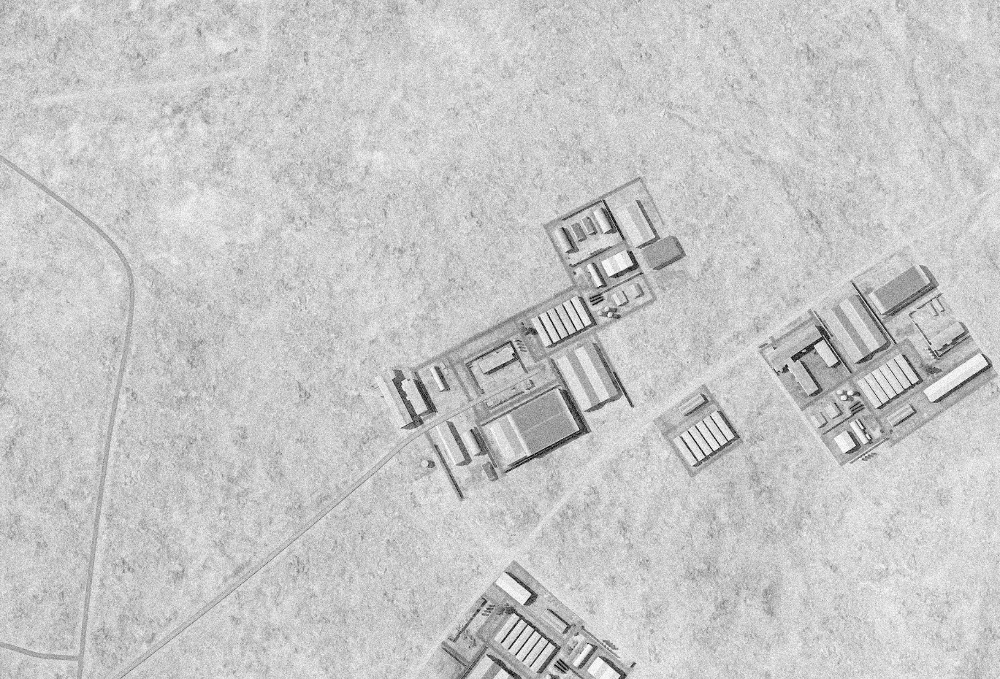
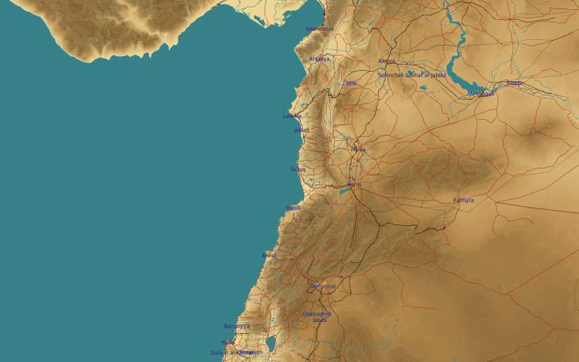
OPARTGT026 DAMASCUS W VEHICLE FACTORY
N
26
6
5
DESIRED POINT of IMPACT:
DPI 6 - N33 29.152 E 36 05.789 / 3256ft / 2000lb PGM
DPI 5 - N33 29.144 E 36 05.900 / 3264ft / 2000lb PGM
DPI 4 - N33 29.136 E 36 05.884 / 3260ft / 2000lb PGM
DPI 3 - N33 29.082 E 36 05.837 / 3250ft / 2000lb PGM
DPI 2 - N33 29.084 E 36 05.847 / 3249ft / 2000lb PGM
DPI 1 - N33 29.077 E 36 05.800 / 3245ft / 2000lb PGM
3
4
2
1
CDC - NSTR.

